Slide 1
Messages From Research
“Educational outcomes for young adults who remained under the care and supervision of the child welfare system were much better than those of young adults who had left care”(Wade, 1997).
“Probably the most critical factor for children looked after is the age at which they move on from being in care to living elsewhere, compared with the population at large”(Broad, 2007).
“Time and again, young people and workers told us about a strong culture that assumed 16 was the age at which young people should leave care” (SCCYP, 2008).
If we want to improve leaving care transitions, we need to improve the in-care experience (Stein, 2012)

Slide 2
Moving Out & Moving On..
Discuss the age at which you left home….
Why was that…
Where did you go…
Was this planned or unplanned…
What sort of preparations did you make…
What sort of support did/do you have…
What sort of emotions did this invoke…
Do you (did you) think you were ready…

Slide 3
Leaving home & leaving care in Scotland
25+ | Average age for leaving home in Scotland | 17 | Average age for leaving care
There has been a 20% increase in 20-34 year olds living with parents since 1997.
29% | Young Men | 18% | Young Women
  Scottish Government Statistics

Slide 4
Sweet 16…?
The average age of leaving care….
Time and again, young people and workers told us about a strong culture that assumed 16 was the age at which young people should leave care.
Sweet 16? The Age of Leaving Care in Scotland SCCYP 2008

Slide 5
One Care Journey
Pre-Care Experience
Looked After Experience
Pre-birth
Neural Development
Parenting Capacity/Care Experience
Developmental Milestones
Trauma, Neglect & Abuse
Pre Care experiences
Transition Into Care
Attachment & Resilience
Transitions & Aftercare
Age at entry into care setting
Family & sibling contact
Identity
Multiple Placements & Transitions
Stability & Consistency
Felt Security
Educational Experience
Connection & Belonging
Age at moving out/moving on
Person-Centred Planning
Staying Put & Continuing care
Extended & Graduated Transitions
Relationship-Based Practice
Connection & Belonging
Aspirations & Expectations
Post care Support into adulthood
Continuing relationships

Slide 6
Young people’s comments
“They’re saying to me ‘sooner or later someone’s going to need that bed’. They make you worry and feel guilty.”
“I was saying I wasn’t ready but felt I had to go.”
“I know a lot who’ve left at 16/17.A few are working or are at college. Others just sit there. Nothing to do, no money…If you start working you pay your own B&B.”
  Sweet 16? The Age of Leaving Care in Scotland SCCYPP 2008

Slide 7
Sweet 16 recommendation 3
Firm steps must be taken to change the culture that expects young people to leave care at 16. Local authority policy and practice should emphasise that proper care until 18, and appropriate support thereafter, is a right and not an option
  Sweet 16? The Age of Leaving Care in Scotland SCCYPP 2008

Slide 8
Underlying implications
The underlying implication of social policy is that young people do not reach full adulthood until the age of 25. Until that point benefit and grant rules make it clear that there is an expectation that they can remain financially dependent upon their parents.

Slide 9
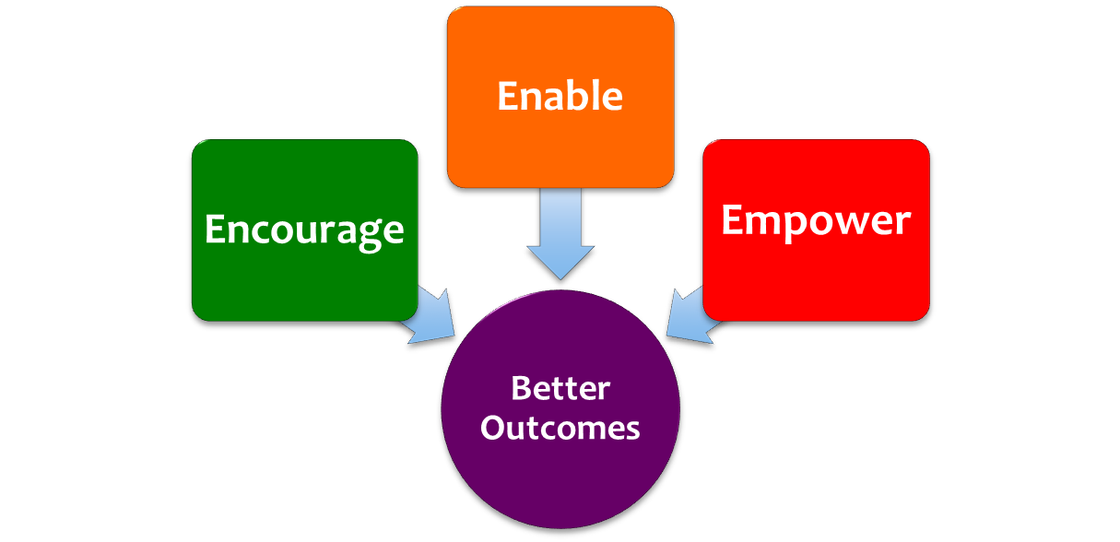
Staying Put Scotland 2013:
An Explicit Philosophy of Care
Staying Put: looked after young people are encouraged, enabled and empowered to remain in positive care settings until they are ready to move on towards more independent living.
Graduated & Extended Transitions: ensure the avoidance of accelerated, abrupt transitions from care settings for looked after young people and care leavers
Post Care Accommodation Options: Housing Options Protocols for Care Leavers - Guidance for Corporate Parents and Community Planning Partnerships:
  Staying Put Scotland Providing care leavers with connectedness and belonging
  Guidance for Local Authorities and other Corporate Parents
  http://www.scotland.gov.uk/Resource/0043/00435935.pdf

Slide 10
Children (Scotland) Act 1995 Duties & Powers
S29 of the Children (Scotland) Act 1995 sets out local authority responsibilities to young people who leave care after they are over school leaving age. Under S29 (1) there is a duty – unless the local authority is satisfied that the young person’s welfare does not require it – to advise, guide and assist those under 19.
Under S29(2) there is a power to provide advice, guidance and assistance to young people between 19 and 21 who apply to the local authority, unless the authority is satisfied that the young person’s welfare does not require it. Local authority assistance may be in cash or in kind.
Under S30 the local authority is empowered to give financial assistance towards the expenses of education or training of care leavers under the age of 21years; also under S30(1), assistance may be granted to meet expenses in respect of accommodation and maintenance in any place near his/her employment.

Slide 11
The Children and Young People
(Scotland) Act 2014
Corporate Parenting (Part 9): identifies additional range of Corporate Parents and imposes new duties upon them
Aftercare (Part 10): extends the entitlement to receive advice, guidance and assistance from the local authority up to their 26th birthday (subject to assessment of eligible needs)
Continuing Care (Part 11): Duty on local authorities to support young people, 16+ who cease to be looked after, to remain in the same in the same accommodation and receive other assistance, up to their 21st birthday
  http://www.legislation.gov.uk/asp/2014/8/contents/enacted
Notes:
Parts 10 and 11 of the 2014 Act reflect the philosophy of care set out in the Scottish Government’s Staying Put Scotland guidance of October 2013.
This stressed the importance of positively delaying the age of leaving care, and corporate parents’ duty to encourage, enable and empower young people to remain in safe, supported environments for as long they need to.

Slide 12
What is ‘corporate parenting’?
An organisation's performance of actions necessary to uphold the rights and safeguard the wellbeing of a looked after child or care leaver, and through which physical, emotional, spiritual, social and educational development is promoted
  http://www.gov.scot/Resource/0048/00483676.pdf

Slide 13
Continuing Care (Part11)
Continuing Care’ is a legal term introduced by the 2014 Act.
Duty on local authorities to provide care leavers whose final placement was ‘away from home’ with a continuation of the kinds of support they received prior to their ceasing to be looked after (including accommodation in a ‘looked after’ placement).
Young person will have to cease to be looked after to be eligible for ‘Continuing Care’, but the day-to-day experience is same
Exceptions
  Young person leaves accommodation of their own volition
  Accommodation ceases to be available
  Placement would significantly adversely affect the welfare of the young person
  Children & Young People (Scotland) Act 2014

Slide 14
Continuing Care (Part11)
The 2014 Act changes the legal definition of a ‘care leaver’.
From April 2015 any young person who ceases to be looked after on or after their 16th birthday will be classified as a ‘care leaver’.
All looked after children can become ‘care leavers’, including young people who were classified as ‘looked after at home’ and in formal kinship care.
The 2014 Act extends eligibility to ‘Aftercare’ services to care leavers up to their 26th birthday
  Children & Young People (Scotland) Act 2014

Slide 15
Aftercare (Part 10)
‘Aftercare’ is defined as ‘advice, guidance and assistance’. This can include (but is not restricted to) helping a young person to secure accommodation, education and employment opportunities, and financial support.
Any young person who ceases to be looked after by a local authority on or after their 16th birthday will be eligible to ‘Aftercare’ services.
Care leavers aged between 19 and 21 who are currently in receipt of ‘Aftercare’ will be able to continue to receive support up to their 26th birthday
Care leavers aged 19 – 26 will be entitled to request assistance from their local authority. The local authority has a duty to undertake an assessment and, if the care leaver is assessed as having eligible needs which cannot be met by other means, the local authority must ensure these are met
  Children & Young People (Scotland) Act 2014

Slide 16
Definitions
Through care is the on-going preparation and support for young people who have been looked after and who may soon be making the transition to live more independently.
Aftercare is the continuing support, planning and guidance for a young person who has left care or a supported living environment.
  Pathways Handbook Scottish Government 2004

Slide 17
Core message
A core message from research suggests that while leaving care represents a crucial moment in a young person’s life, it needs to be built upon the firm foundation of a stable and positive experience of being looked after during which young people can be adequately prepared for adult life.
  Helping care leavers: Problems and strategic responses Stein, M and Wade, J 2000

Slide 18
TCAC Assessment…
Duty to assess & plan
  The authority has a duty to perform a needs assessment on all currently looked after, compulsory and prospective supported persons. It also has a duty to provide a pathway plan and appoint a life coach for all compulsory and discretionary supported persons, and may provide a pathway plan and a life coach for currently looked after persons
  Timing of assessment
  Only in exceptional circumstances should a young person not have their needs assessment and pathway plan completed before they leave care and a plan in place as to their future.
  Regulations and Guidance on Services for Young People Ceasing to be Looked After by Local Authorities Scottish Government 2004

Slide 19

Pathways Planning
  The focus of Pathways needs to be on gathering views, identifying need, planning action and reviewing progress.
  It is not a form-filling exercise or a one-off event.
  The materials provide the framework
  make it a meaningful process
  take a flexible approach
  keep the young person at the centre
  Pathways Handbook Scottish Government 2004
  http://www.gov.scot/Publications/2004/05/19357/37097

Slide 20
Pathways key messages
  Keep the young person at the centre
  Make it a meaningful process
  Take a flexible approach
  Consider how SHANARRI wellbeing indicators apply to young people leaving care
  Pathways Handbook Scottish Government 2004

Slide 21
Person-centred planning
  There is increasing use in practice of the PCP approach to Pathways planning.
  This approach can better enable the young person to be genuinely at the centre of their leaving care Pathway plan
  It acknowledges the leaving care assessment and plan as a “dynamic” process; and requires a genuine partnership between agencies and care leavers.
Person-Centred Planning In Social Care: JRF Publications
Personalisation Through Person–Centred Planning: DoH
  “A plan of care does not replace the need for a child to have a vision for their life“ (Kiaras Gharabaghi)

Slide 22
The importance of stability at times of transition
  Children and young people do not always leave care post 16. Many experience transitions back from temporary care settings at a younger age.
  It is important for these children to experience as little disruption in other key areas of their lives at these times.
  Maintaining consistent school placements, key relationships, access to hobbies, clubs and friends is crucial in maintaining a sense of control and normality to counter the emotional vulnerability many can experience.

Slide 23
Journeys to Adulthood
  Making the journey to adulthood and independence is a life changing process, not a bureaucratic event and it is crucial that care leavers are not further disadvantaged by having to make abrupt, life changing decisions and transitions at an earlier stage than their peers.
  We know that young people who stay for longer in positive care placements, benefitting from the stability and security that this offers, and leaving later, enjoy better outcomes in terms of education, employment and health.
  As Corporate Parents it is our role to ensure that looked after young people and care leavers are given the very best life chances and opportunities as we would our own children through continuous on-going support

Slide 24
A Sense of Belonging…
  School connectedness is, after family, the next most powerful protective factor in young peoples lives
  Regardless of academic ability or attainment, it is the sense of “belonging” that helps develop emotional resilience.
  Relationships count: Behind most successful young people there is someone who ‘goes the extra mile’ and has ‘made the difference’ – often ‘in spite of’ the system.
  Young people need to be allowed to form attachments and develop good relationships to succeed.
  Blum R & Rinehart P
  Reducing The Risk: Connections That Make A Difference In The Lives Of Youth
  (University of Minnesota 1997)
  Mike Stein Resilience & Young People Leaving Care: JRF 2010

Slide 25

Scottish Care Leavers Covenant (2015)
  A Promise to Act
  Actively endorse the Scottish Care Leavers Covenant and commit to uphold and promote its principles, within and across their remits and responsibilities and;
  Take specific relevant action to fully support and implement the Agenda for Change in order to close the gap and make real our ambitions and aspirations for care leavers

Slide 26
Guiding Principles
  Care-proofing of policy: Corporate parents recognise the vulnerability of care leavers as young adults, with explicit reference to, and prioritisation of them as a ‘protected group’ in policy documents.
  Assumption of entitlement: A default position where care leavers are entitled to services, support and opportunities, up to their 26th birthday. Where discretion exists in definitions of vulnerability or in giving priority access, these are exercised in favour of care leavers.
  Staying Put and Continuing Care: The full and meaningful implementation of Continuing Care where looked after young people and care leavers are actively encouraged, enabled and empowered to ‘stay put’ in positive care settings until they are ready to move on.
  Relationship-based practice: All good practice is based on good relationships, based on understanding, empathy, respect, and ‘stickability’. Young people are supported to maintain positive relationships and attachments with previous carers and professionals throughout their care experience and beyond.
  http://www.scottishcareleaverscovenant.org/

Slide 27
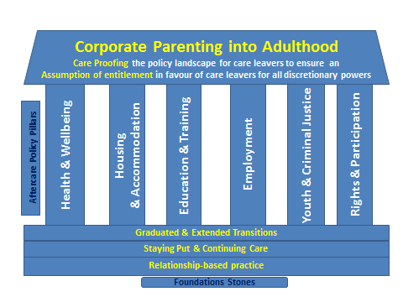

  http://www.scottishcareleaverscovenant.org/

Slide 28
Guidance for local authorities on leaving care
  Social work departments and education departments should work together to ensure that young people who are looked after achieve their maximum potential within the education system. Young people moving to adulthood are often hampered by lack of formal academic qualifications. Good links between social workers and designated teachers will allow young people's progress to be monitored and encouraged.
  Continuing education, training and employment can help young people establish themselves as successful and independent adults. Local authorities should work closely with Careers Scotland who can assist young people in making choices for education and training.
  Regulations and Guidance on Services for Young People Ceasing to be Looked After by Local Authorities Scottish Government 2004

Slide 29
Promoting a culture change
  We need to raise the age at which young people leave care by challenging unrealistic expectations and encouraging, supporting and enabling young people to remain in positive care placements until they are able and ready to move on.
  We need to extend the transitional timescale for moving on – avoid cliff edge transitions/point-of-no-return scenarios. Most of us leave home on a graduated basis over several years.
  Care leavers should have the same opportunities of “returning “home” to care settings” when things don’t work out first time around
  If this was your child or young person, what would you do?

Slide 30
Creating a Corporate Parenting Culture
  Local authorities and key agencies provide young people who have been looked after with on-going support into adulthood, as any other responsible parent would for their children.
  All local authority departments recognise that they have responsibilities to ensure the welfare of looked after and formerly looked after children and young people.
  All agencies work together to play their part in meeting the wide range of young peoples needs
  Local authorities have a corporate parenting group or committee and a named senior person in each department to be accountable for ensuring that corporate parenting responsibilities are fulfilled
  Every local authority has a statement of intent on how they will fulfil their corporate parenting responsibilities for all looked after and formerly looked after children and young people.
  Striving to ensure that looked after young people can achieve the best possible positive outcomes in life.
  “How Good Is Your Throughcare & Aftercare Service
  Scottish Throughcare & Aftercare Forum

Slide 31
Age of children ceasing to be looked after 2010
6% of children ceasing to be looked after had been looked after for under six weeks. A further 14% had been looked after for five years or more. Around 29% had been looked after for less than a year.
  Scottish Government – Children’s SW Statistics 2012

Slide 32
Young people eligible for aftercare services
Accommodation | Age |  |  |  | Total | %
 | 15-16 | 17 | 18 | 19-21
Home with (biological) parents | 111 | 141 | 132 | 110 | 494 | 13
Home with newly-adoptive parents | * | * | 0 | * | 2 | 0
Friends / relatives | 25 | 82 | 68 | 66 | 241 | 7
Own tenancy / independent living | 34 | 133 | 193 | 366 | 726 | 20
Supported accommodation / semi-independent living | 38 | 83 | 80 | 93 | 294 | 8
Former foster carers | * | * | 15 | 24 | 46 | 1
In residential care | 11 | * | 15 | * | 34 | 1
Homeless | 11 | 27 | 35 | 32 | 105 | 3
In custody | 11 | 27 | 35 | 32 | 105 | 3
Other destination | 17 | 21 | 23 | 33 | 94 | 3
Not known | 53 | 80 | 109 | 221 | 463 | 13
Not receiving aftercare | 200 | 326 | 327 | 250 | 1103 | 30
Total | 504 | 916 | 1017 | 1225 | 3662 | 100
  Scottish Government – Children’s SW Statistics 2012
  Young people eligible for aftercare services on 31st July 2011, by age and type of accommodation

Slide 33
Transient situations
Young people who have been in care may return to the family home but this can be a transient situation and often disrupts leaving care arrangements, particularly accommodation provision.
Young people who find it difficult to keep to the rules of accommodation provision can be excluded from having access to the services they need although they might be among the most vulnerable of those leaving care
  Review of Research on Vulnerable Young People and Their Transitions to Independent Living TSE 2007

Slide 34
Economic activity of young people eligible for aftercare services 2010/11
64% of all care leavers whose economic activity status was known were not involved in education, training or work.
Young care leavers who have a disability may find it more difficult to make a transition to adult life. They have often missed large amounts of education and there is very little specialised support to enable them to take up employment. Many young people with severe disabilities stay in education until they are 19, and then go on to day care centres or FE colleges that have relevant courses. Those with mild or moderate disabilities can find themselves repeating the same training course several times because this has been made a condition of their receiving welfare benefits
  Scottish Government – Children’s SW Statistics 2012

Slide 35
Continuing impact of trauma
I would love to go and get a job, but it’s like my maths is atrocious … I get really panicky if I feel that I can’t do something ... I’d love to go to college, but I’m scared of being bullied again. Go through all the trauma and everything just … how can I say? Just the thought of going, it scares me, scares the life out of me.
  The experiences of young care leavers from different ethnic groups JRT 2005

Slide 36
Everything comes at once
Having all the worries of, what am I going to do? Am I going to life independently? Semi-independence? Where am I going to live? … all the worry of what decision I’m going to make career-wise, and then all the worries of my exams … Also there are other problems with puberty; your body’s changing a lot as well at that time …”
  What Makes The Difference Project 2007

Slide 37
Family Firm Opportunities
Good parents help their children with opening doors to employment opportunities, directly or indirectly - often in the “family firm”.
There are a growing number of examples of how local authorities can help re-dress the disproportionate disadvantage faced by looked after young people and care leavers when faced with access to an increasingly competitive and limited youth jobs market
Often as the areas largest employers, local authorities are uniquely placed to offer dedicated employment opportunities to their looked after young people – either directly or through tendering and outsourcing protocols.
If this was your child or young person, what would you do to help them secure employment?
  Our Family Firm: A Working Framework for Community Planning Partners and Employers Scottish Govt: 2011

Slide 38
Supporting Higher & Further Education
Young people with a care background may have experienced some disruption in their education. We know that educational outcomes can poorer. However we also know that looked after young people and care leavers can go on to successfully achieve through higher and further education.
Developing positive relationships with local colleges and universities and developing information sharing protocols and support structures can greatly assist care leavers to overcome some of the obstacles they may face in moving onto and sustaining higher & further education.
The Buttle UK Quality Mark for Care Leavers is awarded to further and higher education providers who demonstrate their commitment to young people in and leaving care.
  The Buttle UK Quality Mark Model: Working with your institution to support Care Leavers in HE
  Buttle UK / University of Bradford 2012

Slide 39
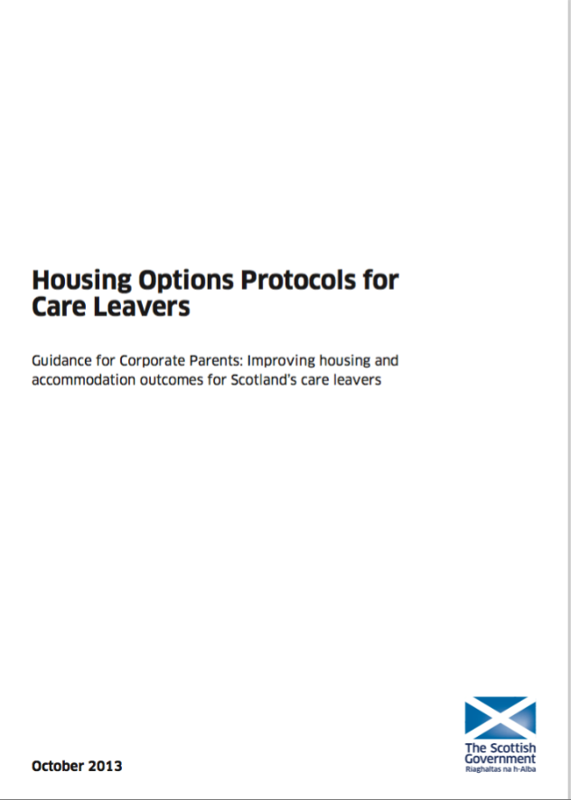
Post Care Accommodation
When young people do eventually move on it is essential that they move into appropriate accommodation which is:
Safe
Secure
Stable
Supported
Somewhere you be happy to see your own child settled…
  http://www.gov.scot/Resource/0043/00435939.pdf
  https://www.celcis.org/files/7114/3938/6983/Inform-Housing_Options_and_Care_Leavers.pdf

Slide 40
What is associated with good outcomes for care leavers?
Stable care careers
Continuous schooling
Foster care background
Encouragement of carers to do well
Carer seeing promoting education as one of their central tasks
Birth parent valuing education
High realistic aspirations
Life skills preparation
Leaving care older than age 16
Good social networks, relationships and self esteem
Stability in accommodation after leaving care
Support from leaving care team

Slide 41
Aspirations
I would have liked, in the personal development plans, I would have liked them to lay out ‘Where do you want to go in the future?... What are your aspirations? Where would you like to go? How can we help you develop as a person?’ Because if you’re developed as a person then you can live on your own more successfully generally. I would have liked them to ask me … courses or places to look for courses. But I didn’t get none of that.
  The experiences of young care leavers from different ethnic groups JRT 2005

